Slide 1

Intro to Relational Database Design
The 3 rules of database design
Example: MovieLens
Indexing to improve performance
Stored procedures
Transactions

Slide 2
Database design
Database design is an art…
But there are 3 fundamental rules to always consider

Slide 3
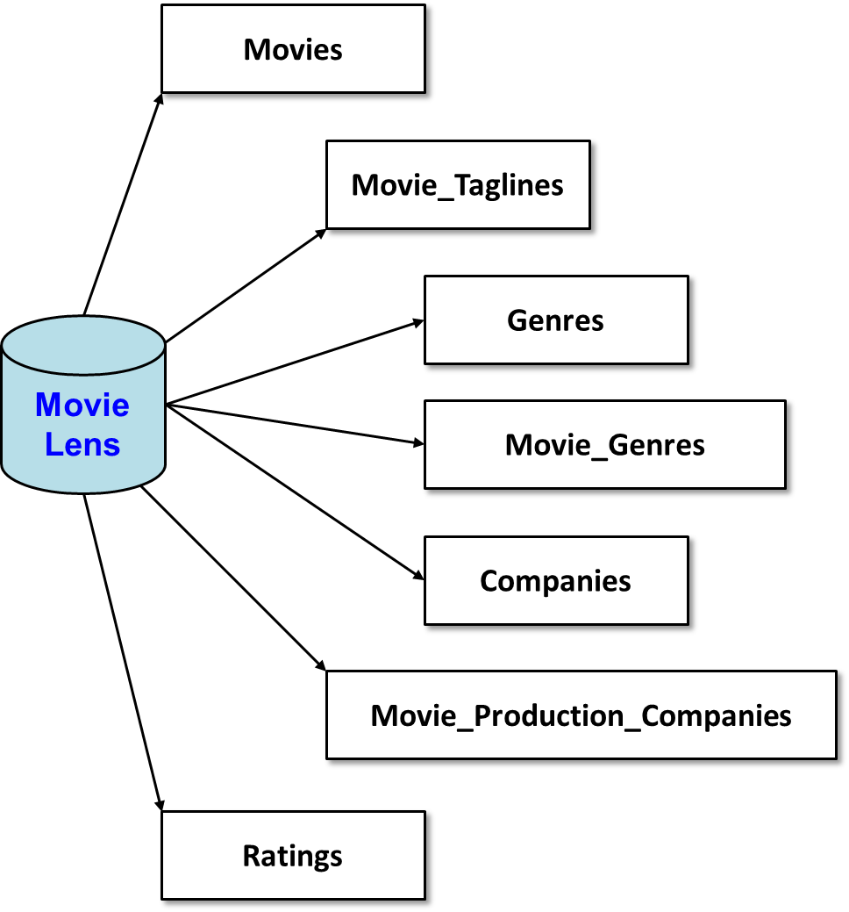
MovieLens database
MovieLens
https://movielens.org/
45K movies
26M reviews
Why 7 tables?

Slide 4
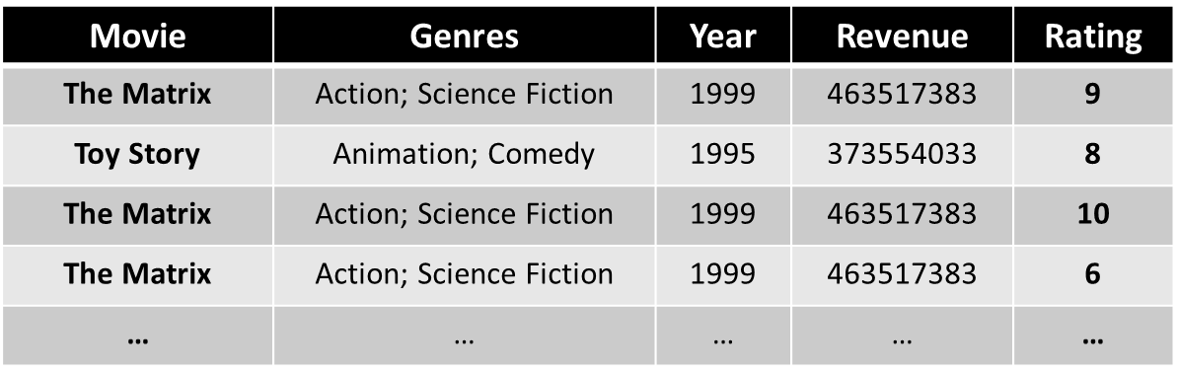
Three fundamental rules of DB design
Store data exactly once
Every row has a unique key to identify that row
Store one value per cell
Original data (csv file)

Slide 5
Movie_ID | Title | Release_Date | Runtime | Original_Language | Budget | Revenue
603 | The Matrix | 1999-03-30 00:00:00.000 | 136 | en | 63000000 | 463517383
862 | Toy Story | 1995-10-30 00:00:00.000 | 81 | en | 30000000 | 373554033
… | … | … | … | … | … | …
Movies
Movie_ID | Rating
605 | 8
603 | 6
605 | 10
605 | 6
… | …
Ratings
Movie Lens
Genres
Movie_Genres
Movie_ID | Genre_ID
862 | 16
862 | 35
603 | 28
603 | 878
… | …
Genre_ID | Genre_Name
28 | Action
878 | Science Fiction
16 | Animation
35 | Comedy
… | …
Notes:
Movie_Genres is called a linking table…

Slide 6
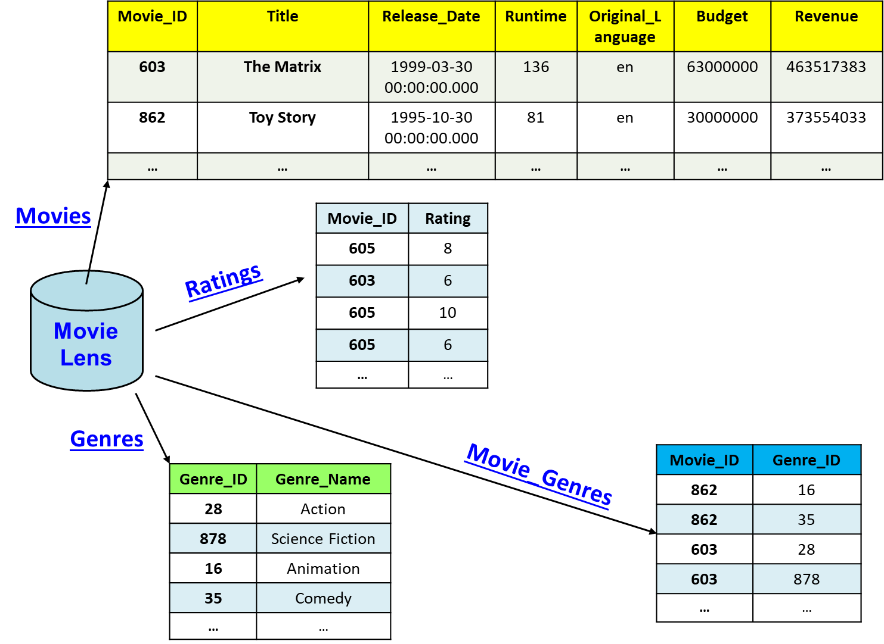
Primary Key
Primary key --- unique row identifier. Every table should have a PK.

Slide 7
Foreign Key
Foreign key --- a primary key stored in another table. FK is what allows data to be joined back together.

Slide 8
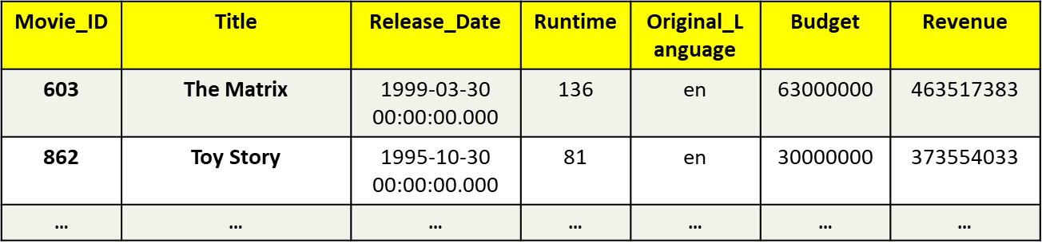
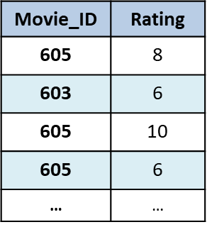
Creating MovieLens using DDL
Databases are created using SQL…
CREATE DATABASE MovieLens;
CREATE TABLE Movies(
Movie_ID INT NOT NULL,
Release_Date TEXT NOT NULL,
Runtime INT NOT NULL,
Original_Language TEXT NOT NULL,
Budget INT NOT NULL,
Revenue INT NOT NULL,
Title TEXT NOT NULL,
PRIMARY KEY (Movie_ID)
);
CREATE TABLE Ratings(
Movie_ID INT NOT NULL,
Rating INT NOT NULL
-- no primary key --
FOREIGN KEY (Movie_ID) REFERENCES Movies (Movie_ID)
);
Notes:
This is sqlite, types may differ by DBMS…

Slide 9
Constraints
Databases allow constraints on data – use them!
CREATE DATABASE MovieLens;
CREATE TABLE Movies(
Movie_ID INT NOT NULL,
Release_Date TEXT NOT NULL,
Runtime INT NOT NULL,
Original_Language TEXT NOT NULL,
Budget INT NOT NULL,
Revenue INT NOT NULL,
Title TEXT NOT NULL,
PRIMARY KEY (Movie_ID)
);
CREATE TABLE Ratings(
Movie_ID INT NOT NULL,
Rating INT NOT NULL CHECK(Rating >= 0
AND Rating <= 10),
-- no primary key --
FOREIGN KEY (Movie_ID) REFERENCES Movies (Movie_ID)
);

Slide 10
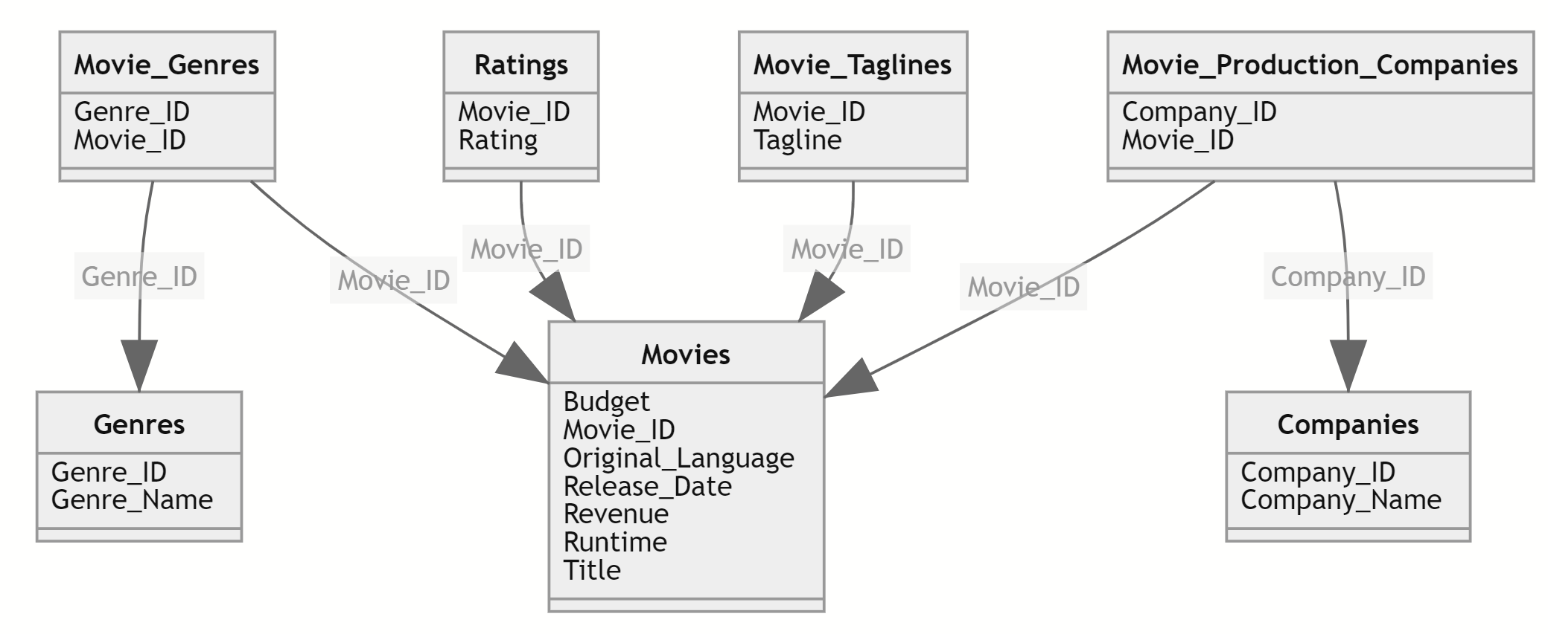
Database schema (design)
One view is the SQL used to create the database
Another view is some sort of visual diagram…
Produced by Azure Data Studio via “Schema Visualization” extension
Notes:
The arrows imply the FK and PK relationships. Most DBMS tools produce these automatically, e.g. the above is from Azure Data Studio, via extension (“Scheme Visualization”)

Slide 11
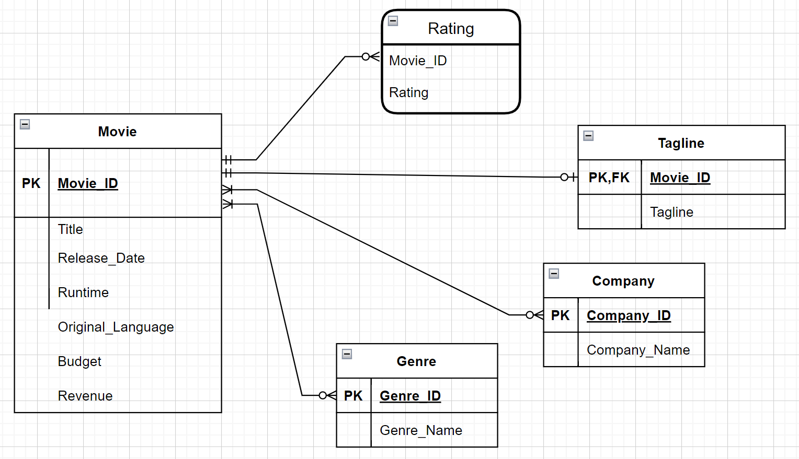
ER Diagram
Entity Relationship diagram…
More formal approach, and the most common
Entity, not Table
Drawn manually using free tool: https://app.diagrams.net/
Notes:
Open this in https://app.diagram.net/, see underlying .xml file. First it’s a higher-level diagram, in terms of entities, and not lower-level tables. Also, pay close attention to the arrows, discussed on the next slide…

Slide 12
Types of relationships
1-to-1
1-to-many
many-to-many

Slide 13
Question
Interestingly, what low-level detail is *missing* from the ER diagram?

Slide 14
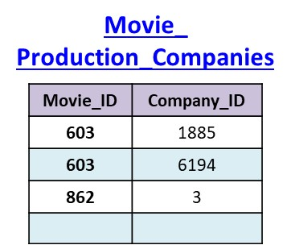
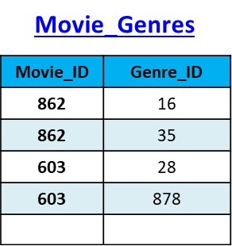
Answer
Many-to-many relationships imply a linking or bridge table to implement the connection…
Notes:
Movie_Genres and Movie_Production_Companies tables are called linking or bridge tables

Slide 15
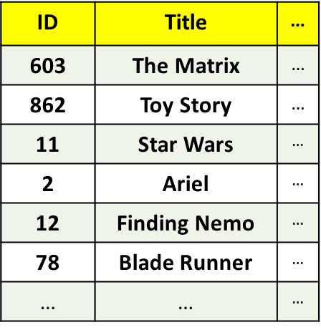

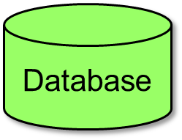

Performance: Scan vs. Seek
By default, DBMS has to “scan” when searching
Row by row search of all movies in persistent store (file sys)
Example:
Searching for a movie by title
Storage
(persistent)
SELECT *
FROM Movies
WHERE Title = 'Blade Runner';

Slide 16
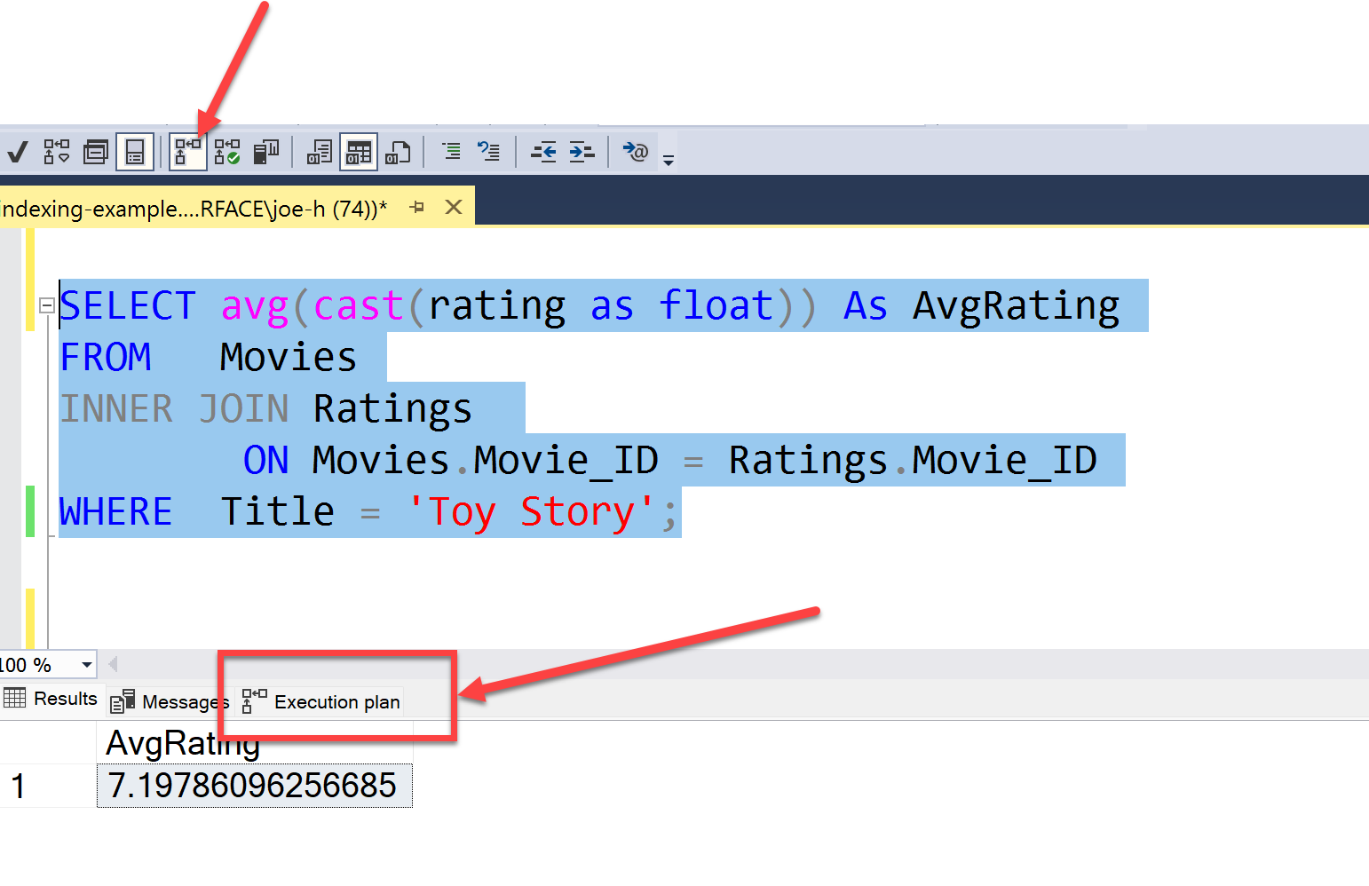
Query plan
Query plan is how DBMS plans to execute query
Most database tools can display plan…

Slide 17
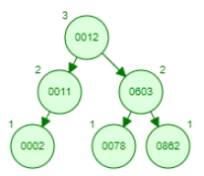
Indexing
With an index, DBMS can “seek”
Search of volatile memory + 1 access to persistent store
Primary key always indexed
DBMS builds @ startup
Indexes data residing in persistent storage
Memory
(volatile)
Storage
(persistent)
row
row
row
row
row
row
File
SELECT Title
FROM Movies
WHERE Movie_ID = 78;
Notes:
“nodes” in the index contain “keys” / “pointers” (really file positions) of the underlying data for that index value. In this case assume movie ids. Show how the search is performed on this structure with ID = 78… Also talk about volatile memory vs. persistent memory (e.g. SSD)

Slide 18
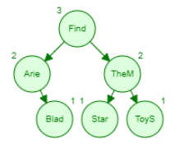
Example #1
Searching by movie id is fast (primary key is indexed)
Searching by movie title is slow --- add index!
Memory
(volatile)
Storage
(persistent)
SELECT Title
FROM Movies
WHERE Title = 'Blade Runner';
CREATE INDEX Title_Index ON Movies(Title);
Notes:
Use Sql Server MGMT studio to execute query, and enable option to view query plan
Select * from Movies
Where Title = 'Toy Story';
Create Index Title_Index on Movies(Title);
Drop Index Movies.Title_Index;

Slide 19
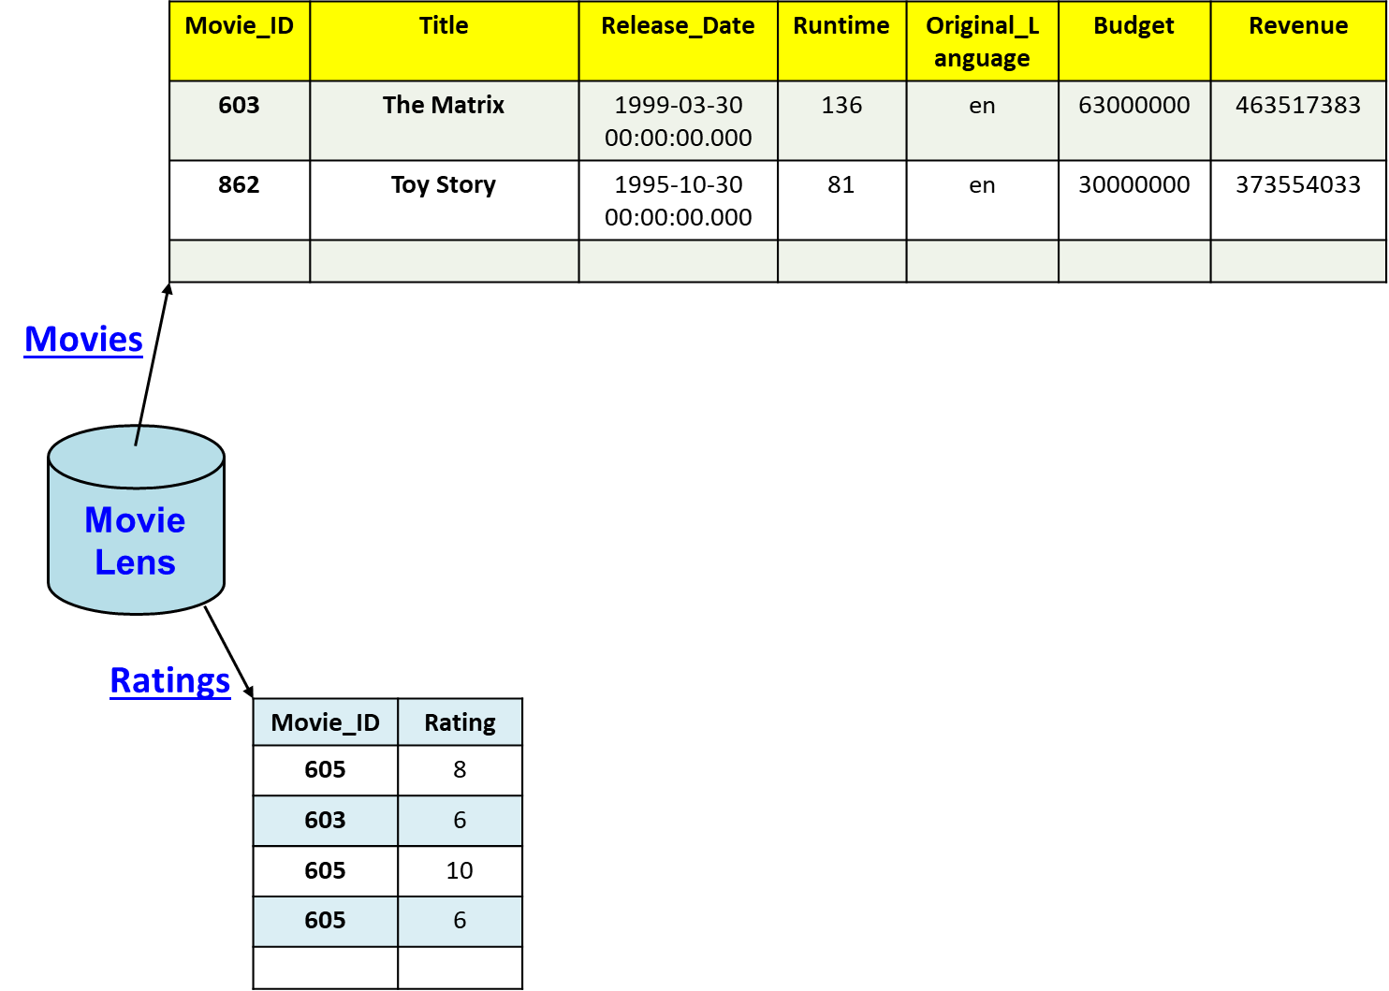
Example #2
There are 26MB reviews
Computation of avg rating…
SELECT Avg(cast(Rating as float))
FROM Movies
INNER JOIN Ratings
ON Movies.Movie_ID = Ratings.Movie_ID
WHERE Title = 'Toy Story';

Slide 20
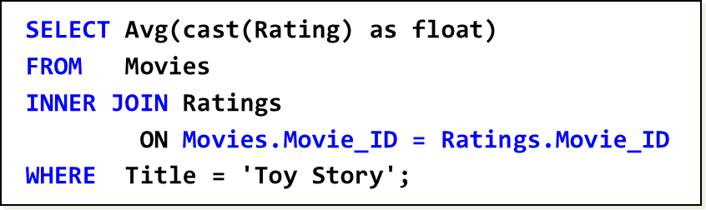
Demo
Without index, query takes 4-5 seconds…
Not bad, but we can do much better…
Notes:
Use Sql Server MGMT studio to execute query, and enable option to view query plan…

Slide 21
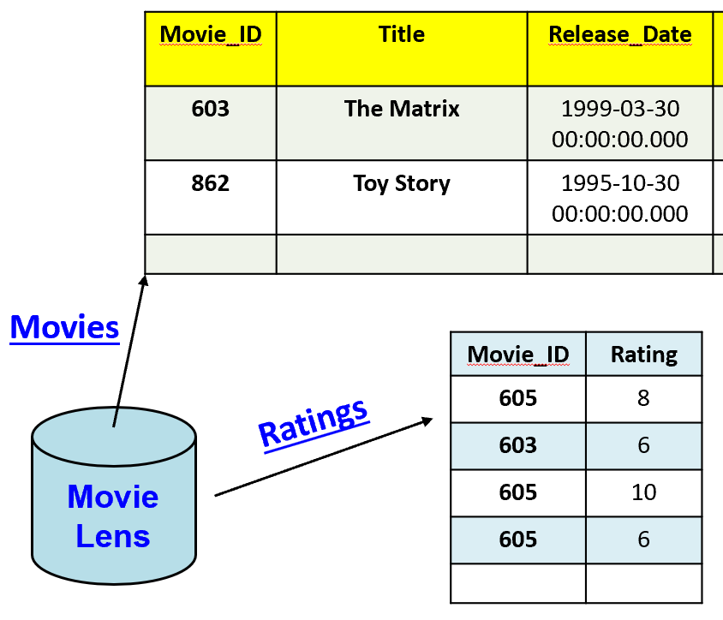
Solution : index Ratings by Movie_ID
With correct index, query takes 1/10th of a second
CREATE INDEX Ratings_Index ON Ratings(Movie_ID);
Notes:
We already did the Title earlier, but there are onlyl 45K movies so that's not a big deal. The Ratings table has 26M reviews, so that's the issue…

Slide 22
Trade-offs
Why not create an index on every column?
Takes more server memory for underlying data structures
Slows down inserts / updates / deletes since have to maintain underyling data structures
General approach is to create indexes on the obvious columns, then deploy and monitor
See how DB is used, and add more indexes as needed

Slide 23

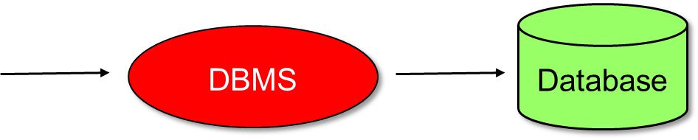
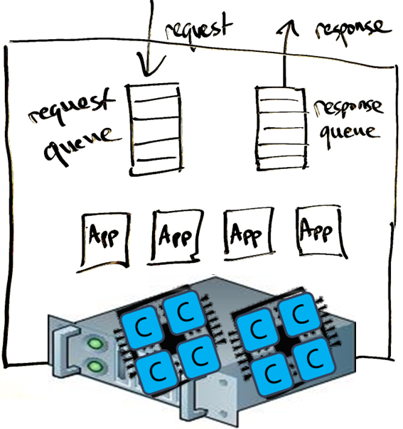
Databases are powerful systems
Can handle thousands of concurrent users
Handle simultaneous insert / update / delete
Take advantage of multi-core hardware

Slide 24
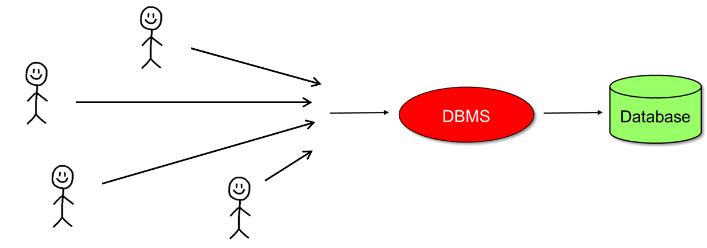

Question
We are building a ticket selling app
everyone is trying to buy 2 tickets
This is unsafe in a multi-user scenario. How to fix?
sql = 'Select num_avail From Tickets Where eventid=1234;'
dbCursor.execute(sql);
row = dbCursor.fetchone()
numAvail = int(row[0])
if numAvail >= 2:
success = True
sql = "Update Tickets Set num_avail = num_avail-2 Where eventid=1234;'
dbCursor.execute(sql)
else:
success = False
Notes:
Note that most ticket selling apps give you 5-10 minute window, but it's same principle. They have to "buy" the tickets, and then return them if the user doesn't buy them in the time window. But the initial "buy" is still a two-step process: select to find 2, then update database so no one else buys them as well.

Slide 25
Solution: Transactions
Transaction isolate operations from other users
Transactions make a series of operation atomic
BEGIN TRANSACTION;
-- withdraw from checking
UPDATE Accounts
SET Balance = Balance – 100.00
WHERE Account = 22197;
-- deposit into savings
UPDATE Accounts
SET Balance = Balance + 100.00
WHERE Account = 43992;
COMMIT;

Slide 26
Beware
For better performance, transactions default to "not-quite-perfect" isolation between users
Solutions
isolation level = Serializable
default isolation level + "Select … For Update;"
BEGIN TRANSACTION
sql = 'Select num_avail From Tickets Where eventid=1234 For Update;'
dbCursor.execute(sql);
row = dbCursor.fetchone()
numAvail = int(row[0])
if numAvail >= 2:
success = True
sql = "Update Tickets Set num_avail = num_avail-2 Where eventid=1234;'
dbCursor.execute(sql)
COMMIT
else:
success = False
ROLLBACK
This level of understanding is why you want DBAs writing stored procedures

Slide 27
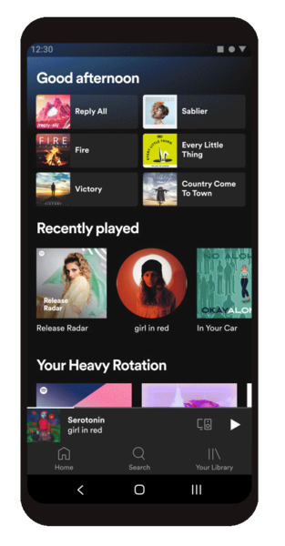
Design: who executes the SQL?
Client
(project 01)
(3) Stored Procedures
(2) Server
(project 02)
Notes:
Client-side: most flexible, quick to build apps, but (1) are client-side programmers good with SQL, and (2) are you storing DB login / pwd on client now?
Server-side: usually server-side programmers are more experienced / better with SQL, and now DB login / pwd protected within server.
Within DB: provide functionality via stored procedures, most secure and written by most experienced devs. But slower to design / add / change.

Slide 28
Design: who executes the SQL?
Client
(project 01)
(3) Stored Procedures
(2) Server
(project 02)
Notes:
Client-side: most flexible, quick to build apps, but (1) are client-side programmers good with SQL, and (2) are you storing DB login / pwd on client now?
Server-side: usually server-side programmers are more experienced / better with SQL, and now DB login / pwd protected within server.
Within DB: provide functionality via stored procedures, most secure and written by most experienced devs. But slower to design / add / change.

Slide 29
Stored Procedures
Functions stored in the database
Support parameters and nearly all features of SQL
Can retrieve, insert, update, and delete data
EXEC AddMovieReview 603, 10;
--
-- inserts a review into the database
--
Create Procedure AddMovieReview
@id int,
@rating tinyint
As
Begin
BEGIN TRANSACTION;
Insert Into Ratings(Movie_ID, Rating) Values(@id, @rating);
COMMIT;
RETURN @@ROWCOUNT; -- # of rows modified
End;
Notes:
Demo in SQL Server… it's already in the database…

Slide 30
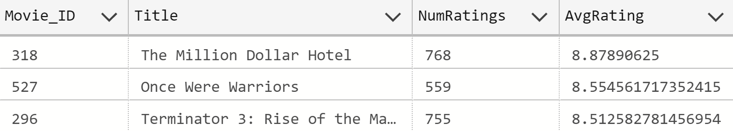
Top N movies with Min ratings
EXEC TopN 3, 500;
--
-- retrieves top N movies with at least Min ratings
--
Create Procedure TopN
@N int, -- retrieve N movies
@Min int -- must have >= Min ratings
As
Begin
Select Top (@N)
Movies.Movie_ID,
Title,
Count(Rating) As NumRatings,
Avg(Cast(Rating as real)) As AvgRating
From Movies
Inner Join Ratings on Movies.Movie_ID = Ratings.Movie_ID
Group By Movies.Movie_ID, Movies.Title
Having Count(Rating) >= @Min
Order By AvgRating DESC, Title ASC;
End;
Notes:
This one is NOT in SQL Server, so add it first, then we can run it.

Slide 31
Why stored procedures?
Faster
More trustworthy!
Typically written by database designer(s)
Experts in SQL
Understand details of database design

Slide 32
That's it, thank you!

Slide 33
Movies
Movie_Taglines
Genres
Movie Lens
Movie_Genres
Companies
Movie_Production_Companies
Ratings

Slide 34
Movie_ID | Title | Release_Date | Runtime | Original_Language | Budget | Revenue
603 | The Matrix | 1999-03-30 00:00:00.000 | 136 | en | 63000000 | 463517383
862 | Toy Story | 1995-10-30 00:00:00.000 | 81 | en | 30000000 | 373554033
Movies
Movie_ID | Rating
605 | 8
603 | 6
605 | 10
605 | 6
Ratings
Movie Lens

Slide 35
Movie_ID | Title | Release_Date | Runtime | Original_Language | Budget | Revenue
603 | The Matrix | 1999-03-30 00:00:00.000 | 136 | en | 63000000 | 463517383
862 | Toy Story | 1995-10-30 00:00:00.000 | 81 | en | 30000000 | 373554033
Movies
Movie_ID | Tagline
603 | Welcome to the Real World.
605 | Everything that has a beginning has an end.
Movie_Taglines
Movie Lens
Ratings
Movie_ID | Rating
605 | 8
603 | 6
605 | 10
605 | 6

Slide 36
Company_ID | Company_Name
1885 | Silver Pictures
6194 | Warner Bros.
Movie_ID | Company_ID
603 | 1885
603 | 6194
862 | 3
Companies
Movie_Production_Companies
Movie_ID | Genre_ID
862 | 16
862 | 35
603 | 28
603 | 878
Movie Lens
Movie_Genres
Genres
Genre_ID | Genre_Name
28 | Action
878 | Science Fiction
16 | Animation
35 | Comedy

